Slide 1
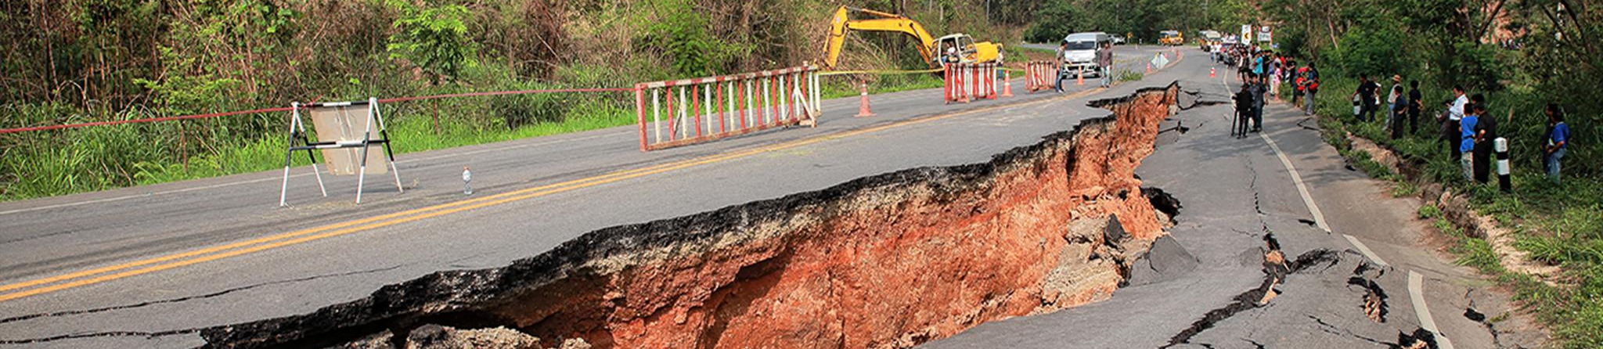
Catastrophe Bond
Time Series Analysis
Christine Lu, Dennis Goldenberg, Luyang Feng

Slide 2
Table of Contents
Introducing CAT bonds
Project Goals
Exploratory Data analysis
Modeling
Results & Comparison
Notes:
Previous values of yield (time Series regression)
Expected Loss
Some measure of credit spread in non-investment grade portion of bond market
https://fred.stlouisfed.org/series/BAMLH0A0HYM2#0
Volume of Market

Slide 3
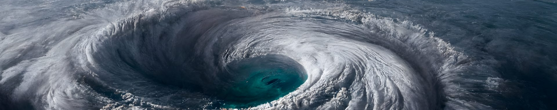
What is a CAT BOND?

Slide 4
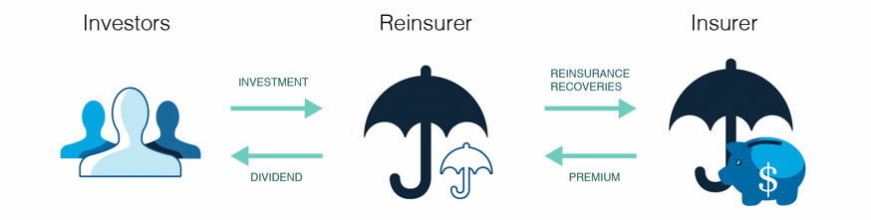
What is Catastrophe (cat) Bond?
A cat bond is a financial instrument issued by a Special Purpose Vehicle (SPV) that allows a sponsor (e.g., an insurer) to transfer catastrophic risk to the capital markets. Investors purchase these bonds, earning interest from the sponsor's premiums and investment income.
If no triggering event (e.g., a natural disaster) occurs, investors receive their principal and interest. However, if a triggering event happens, the bond defaults, and the funds are used to cover the sponsor's insurance claims.

Slide 5
Pricing of Cat Bonds
Pricing Influences:
Determined by reinsurance market dynamics, exposure characteristics, and catastrophe modeling.
Affected by credit spreads in high-yield bonds and transaction costs.
Cat Model Integration:
Calculates default probabilities for covered perils.
Example: A BB-rated bond with a 4% default probability would match a cat bond with a 4% triggering event likelihood.
Cost Breakdown:
Premium is aligned with credit spreads (e.g., 100 basis points or 1% of the insured amount for BB-rated bonds).
High setup costs (SPV creation, filings, modeling) are mitigated by multiyear coverage, reducing per-year expense.

Slide 6
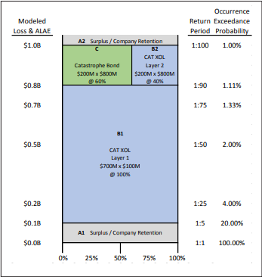
Layer Covered and Terms of Coverage
Layer Placement:
Lower Layers: Covered by Cat XOL treaties only.
Upper Layers: Shared by Cat Bonds and Cat XOL treaties (e.g., 60% of losses > $8M to $1B covered by a Cat Bond, 40% by a Cat XOL treaty).
Coverage Terms:
Cat XOL Treaties:
Annual agreements with reinstatement options to address multiple events.
Cat Bonds:
Multiyear agreements, no reinstatements.
Designed for far tail risks; limited protection for multiple events in one period.

Slide 7
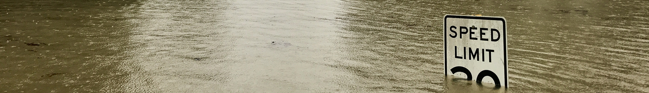
Project Goal and Exploratory Data Analysis

Slide 8
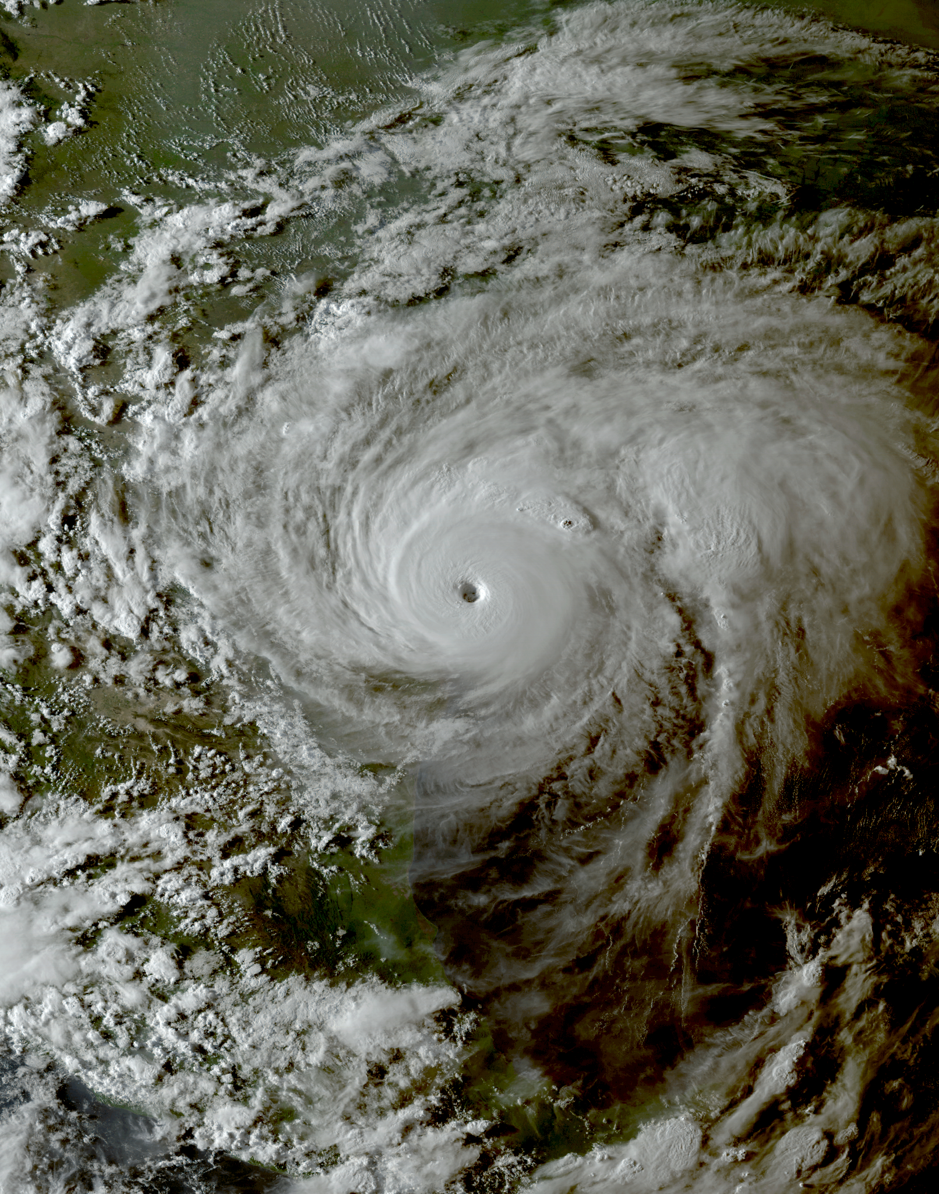
Project Goals
Can we predict cat bond market yield using certain covariates?
Expected Loss
Credit Spread in non-investment grade bond market
3 ARMA Models
Autoregressive terms for market yield
Adds expected loss
Adds expected loss and credit spread.
Look at BIC for comparison of models.

Slide 9

Exploratory Data Analysis
Response: Average CAT Bond Market Yield, called weekly average reinsurance market yield (USD) in the dataset, from 2010-10-08 to 2024-10-25.
Covariates:
Money Market Rate (USD).
Credit_Spread_BofA_weekly (from Federal Reserve Bank of St. Louis).
Expected Loss: the average notional amount expected to be lost on a CAT bond sponsorship.
Total Coupon CAT bond Market (USD) = Average CAT Bond Market Yield + Money Market Rate
Notes:
Artemis.bm is a leading online platform dedicated to providing news, analysis, and data on the catastrophe bond, insurance-linked securities (ILS)

Slide 10
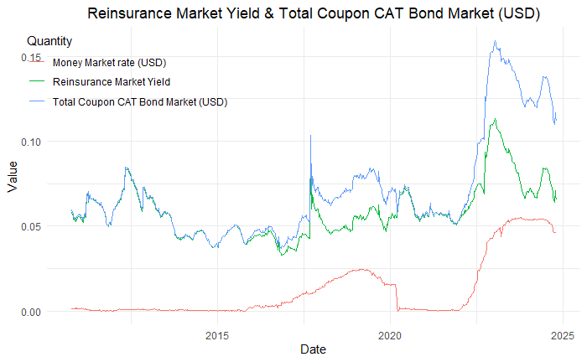
Exploratory Data Analysis – Reinsurance Market Yield & Total Coupon CAT Bond Market
Notes:
Previous values of yield (time Series regression)
Expected Loss
Some measure of credit spread in non-investment grade portion of bond market
https://fred.stlouisfed.org/series/BAMLH0A0HYM2#0
Volume of Market

Slide 11
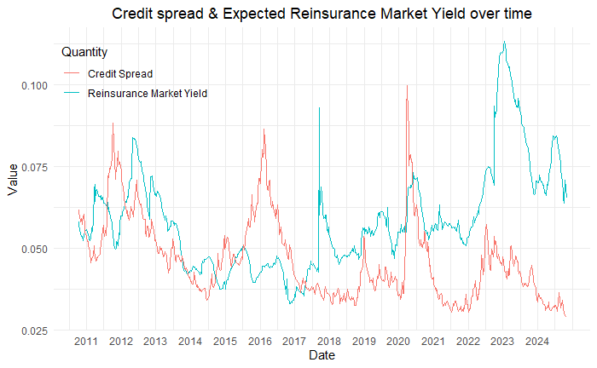
Exploratory Data Analysis – Credit Spread & Reinsurance Market Yield
Notes:
Previous values of yield (time Series regression)
Expected Loss
Some measure of credit spread in non-investment grade portion of bond market
https://fred.stlouisfed.org/series/BAMLH0A0HYM2#0
Volume of Market

Slide 12
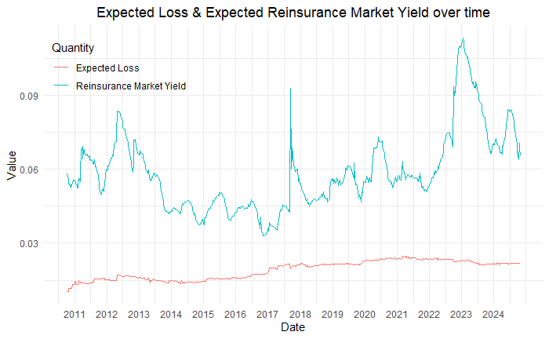
Exploratory Data Analysis – Expected Loss & Reinsurance Market Yield
Notes:
Previous values of yield (time Series regression)
Expected Loss
Some measure of credit spread in non-investment grade portion of bond market
https://fred.stlouisfed.org/series/BAMLH0A0HYM2#0
Volume of Market

Slide 13
Exploratory Data Analysis – Data Pre-processing
Split the data into train and test:
Train Data: 2010-10-08 <= Date <= 2020-10-08 (first 10 years)
Test Data: 2020-10-08 <= Date <= 2024-10-25 (remaining data)
Now, we examine our training data for stationarity:
For response: to know how many times to difference in ARIMA
For explanatory: to evaluate correlation
Notes:
Previous values of yield (time Series regression)
Expected Loss
Some measure of credit spread in non-investment grade portion of bond market
https://fred.stlouisfed.org/series/BAMLH0A0HYM2#0
Volume of Market

Slide 14
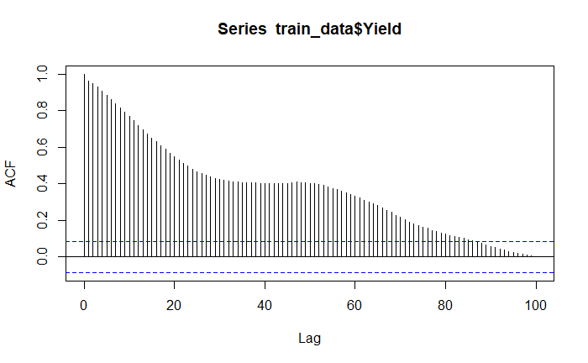
EDA: ACF/Stationarity Analysis – Reinsurance Market Yield
ACF’s slowly descending from 1 - NOT stationary!
Notes:
Previous values of yield (time Series regression)
Expected Loss
Some measure of credit spread in non-investment grade portion of bond market
https://fred.stlouisfed.org/series/BAMLH0A0HYM2#0
Volume of Market

Slide 15
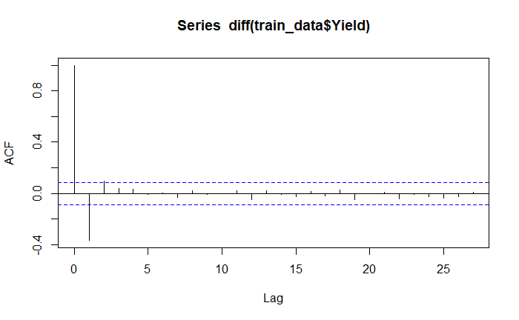
EDA: ACF/Stationarity Analysis – Reinsurance Market Yield
Notes:
Previous values of yield (time Series regression)
Expected Loss
Some measure of credit spread in non-investment grade portion of bond market
https://fred.stlouisfed.org/series/BAMLH0A0HYM2#0
Volume of Market

Slide 16
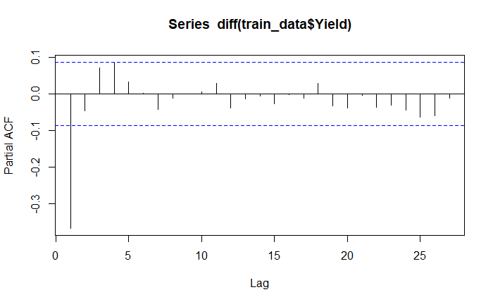
Analysis: ACF/Stationarity Analysis – Reinsurance Market Yield
Notes:
Previous values of yield (time Series regression)
Expected Loss
Some measure of credit spread in non-investment grade portion of bond market
https://fred.stlouisfed.org/series/BAMLH0A0HYM2#0
Volume of Market

Slide 17
Analysis: ACF/Stationarity Analysis – Reinsurance Market Yield
After differencing, looks stationary
Notes:
Previous values of yield (time Series regression)
Expected Loss
Some measure of credit spread in non-investment grade portion of bond market
https://fred.stlouisfed.org/series/BAMLH0A0HYM2#0
Volume of Market

Slide 18
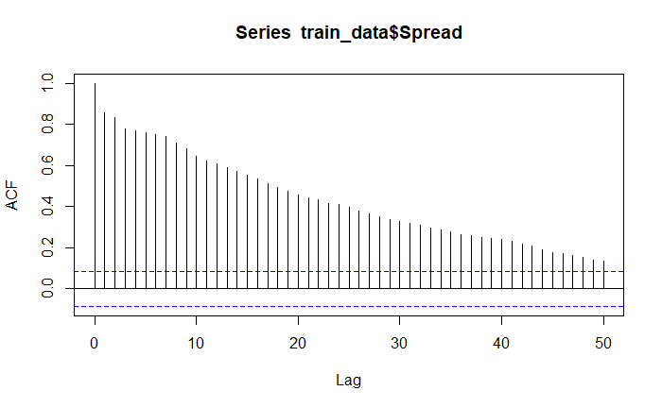
Analysis: ACF/Stationarity Analysis – BofA Credit Spread
ACF’s slowly descending from 1 - NOT stationary!
Notes:
Previous values of yield (time Series regression)
Expected Loss
Some measure of credit spread in non-investment grade portion of bond market
https://fred.stlouisfed.org/series/BAMLH0A0HYM2#0
Volume of Market

Slide 19
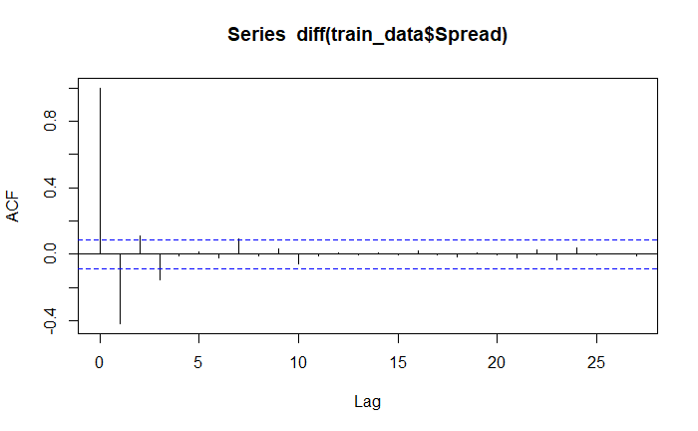
Analysis: ACF/Stationarity Analysis – BofA Credit Spread
Notes:
Previous values of yield (time Series regression)
Expected Loss
Some measure of credit spread in non-investment grade portion of bond market
https://fred.stlouisfed.org/series/BAMLH0A0HYM2#0
Volume of Market

Slide 20
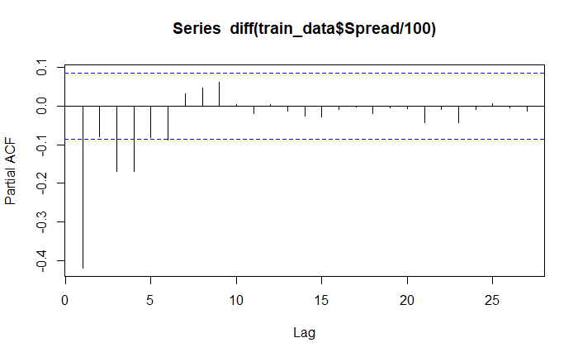
Analysis: ACF/Stationarity Analysis – BofA Credit Spread
Need to analyze further for stationarity
Notes:
Previous values of yield (time Series regression)
Expected Loss
Some measure of credit spread in non-investment grade portion of bond market
https://fred.stlouisfed.org/series/BAMLH0A0HYM2#0
Volume of Market

Slide 21
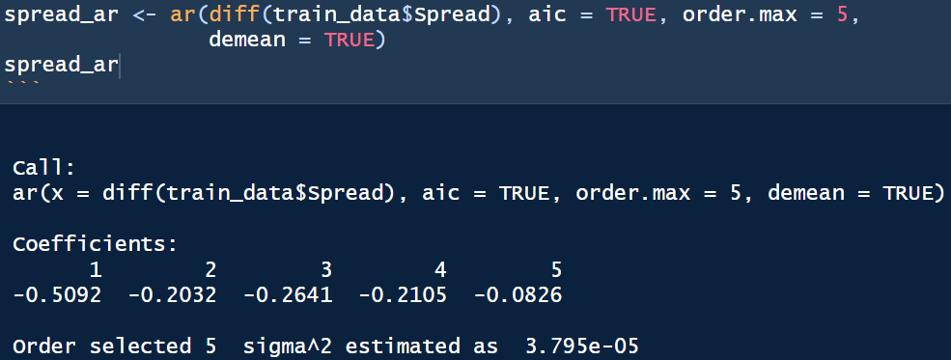
Analysis: ACF/Stationarity Analysis – BofA Credit Spread
All Roots have magnitude significantly > 1, stationary!
Notes:
Previous values of yield (time Series regression)
Expected Loss
Some measure of credit spread in non-investment grade portion of bond market
https://fred.stlouisfed.org/series/BAMLH0A0HYM2#0
Volume of Market

Slide 22
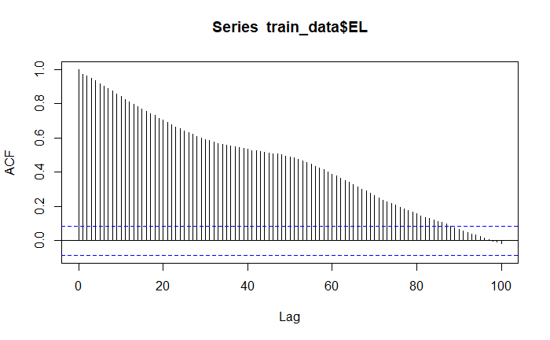
Analysis: ACF/Stationarity Analysis – Expected Loss
ACF’s slowly descending from 1 - NOT stationary!
Notes:
Previous values of yield (time Series regression)
Expected Loss
Some measure of credit spread in non-investment grade portion of bond market
https://fred.stlouisfed.org/series/BAMLH0A0HYM2#0
Volume of Market

Slide 23
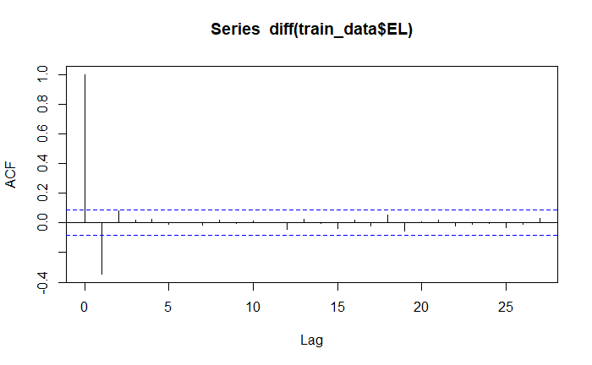
Analysis: ACF/Stationarity Analysis – Expected Loss
Notes:
Previous values of yield (time Series regression)
Expected Loss
Some measure of credit spread in non-investment grade portion of bond market
https://fred.stlouisfed.org/series/BAMLH0A0HYM2#0
Volume of Market

Slide 24
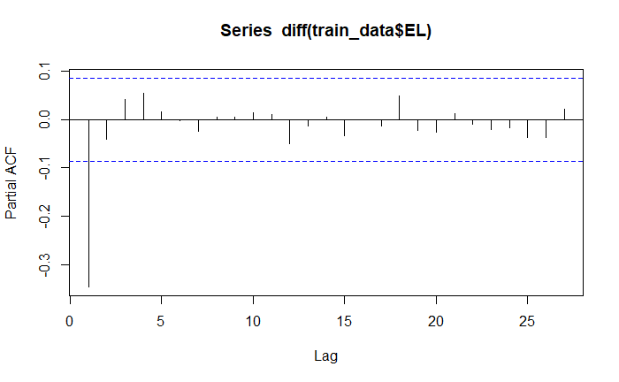
Analysis: ACF/Stationarity Analysis – Expected Loss
Notes:
Previous values of yield (time Series regression)
Expected Loss
Some measure of credit spread in non-investment grade portion of bond market
https://fred.stlouisfed.org/series/BAMLH0A0HYM2#0
Volume of Market

Slide 25
Analysis: ACF/Stationarity Analysis – Expected Loss
After differencing, looks stationary
Notes:
Previous values of yield (time Series regression)
Expected Loss
Some measure of credit spread in non-investment grade portion of bond market
https://fred.stlouisfed.org/series/BAMLH0A0HYM2#0
Volume of Market

Slide 26

Cross-Correlation Analysis

Slide 27
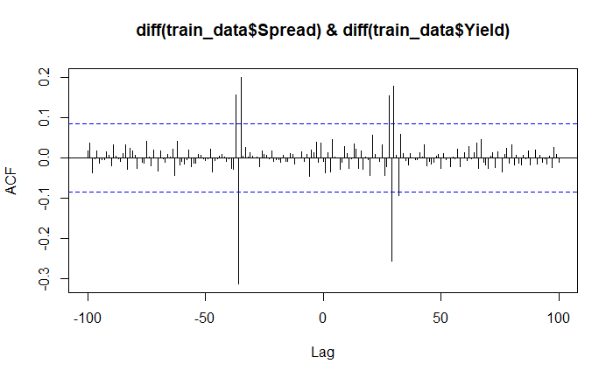
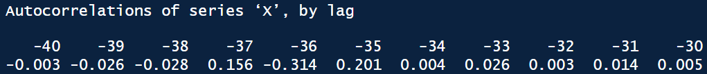
Analysis: Relationships between variables analysis: Credit Spread & Yield
Notes:
Previous values of yield (time Series regression)
Expected Loss
Some measure of credit spread in non-investment grade portion of bond market
https://fred.stlouisfed.org/series/BAMLH0A0HYM2#0
Volume of Market

Slide 28
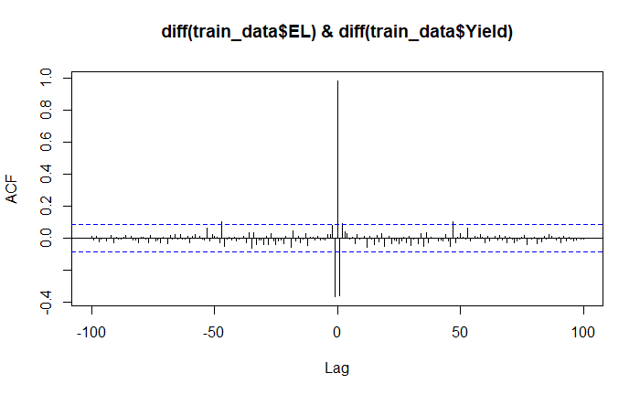
Analysis: Relationships between variables analysis: Expected Loss & Yield
Strongest at 0, we must examine general relationship between EL, Yield
Notes:
Previous values of yield (time Series regression)
Expected Loss
Some measure of credit spread in non-investment grade portion of bond market
https://fred.stlouisfed.org/series/BAMLH0A0HYM2#0
Volume of Market

Slide 29
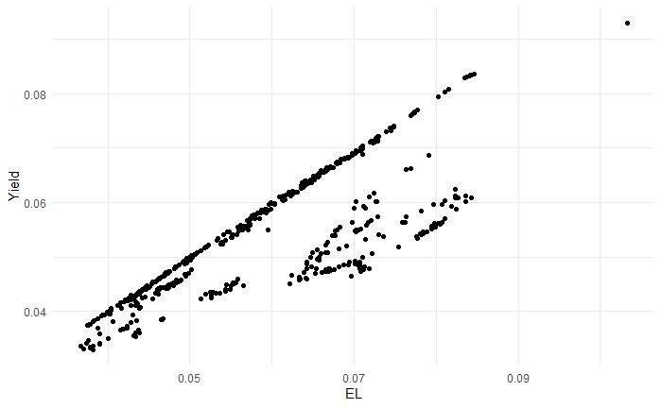
Analysis: Relationships between variables analysis EL & Yield
Strong Correlation, no need to difference
Notes:
Previous values of yield (time Series regression)
Expected Loss
Some measure of credit spread in non-investment grade portion of bond market
https://fred.stlouisfed.org/series/BAMLH0A0HYM2#0
Volume of Market

Slide 30

Model Results & Conclusions

Slide 31
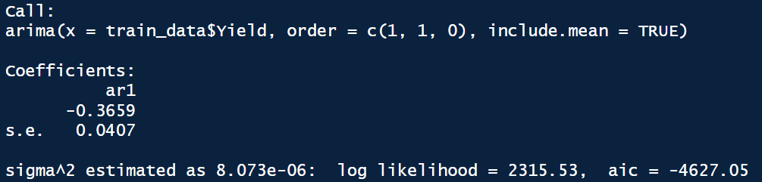
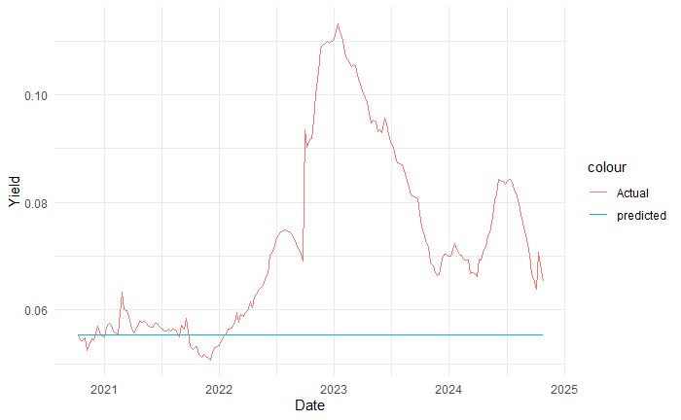
Baseline Model: ARIMA(1,1,0) [No exogenous variables!]
Notes:
Previous values of yield (time Series regression)
Expected Loss
Some measure of credit spread in non-investment grade portion of bond market
https://fred.stlouisfed.org/series/BAMLH0A0HYM2#0
Volume of Market

Slide 32
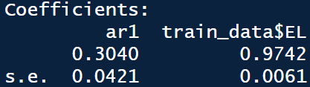
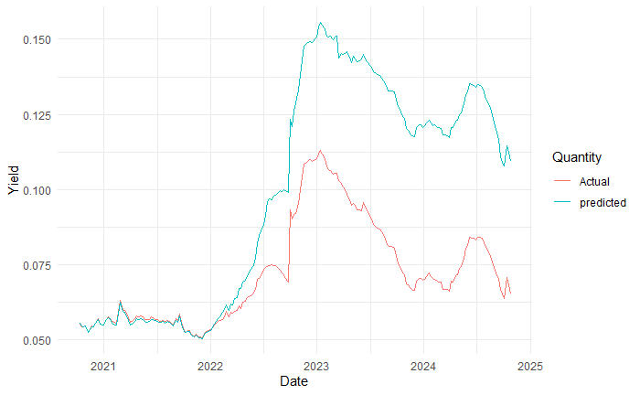
Analysis – ARIMA(1,1,0) [Expected Loss as an Exogenous Variable]
Notes:
Previous values of yield (time Series regression)
Expected Loss
Some measure of credit spread in non-investment grade portion of bond market
https://fred.stlouisfed.org/series/BAMLH0A0HYM2#0
Volume of Market

Slide 33
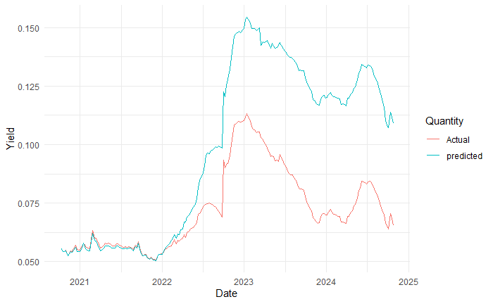
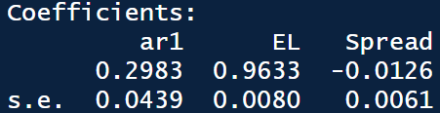
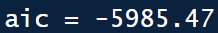
Analysis – ARIMA(1,1,0) with expected loss and credit spread (lag 36)
Notes:
Previous values of yield (time Series regression)
Expected Loss
Some measure of credit spread in non-investment grade portion of bond market
https://fred.stlouisfed.org/series/BAMLH0A0HYM2#0
Volume of Market

Slide 34
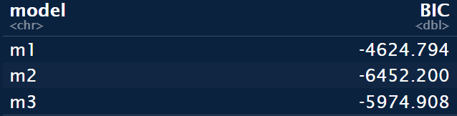
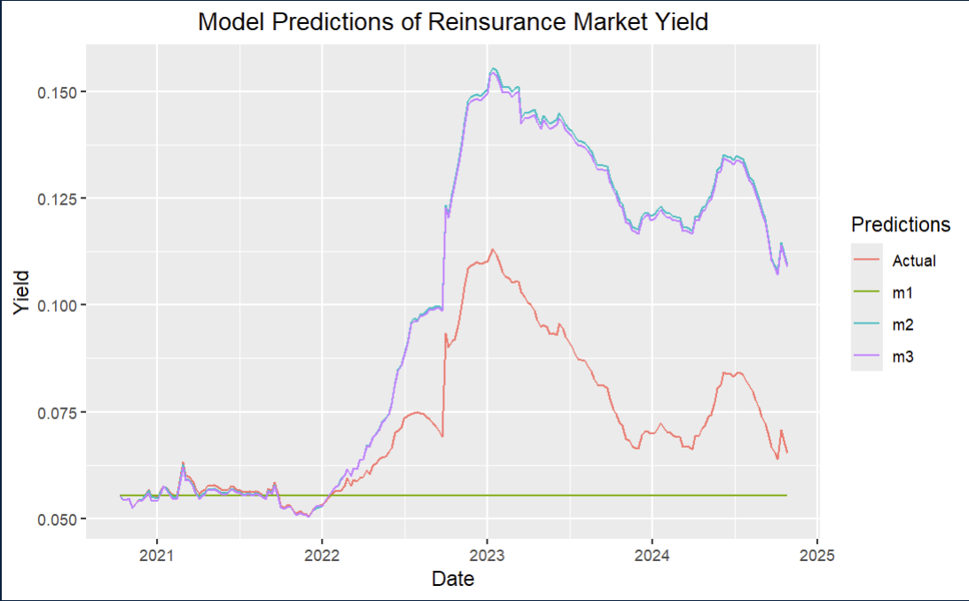
Model Comparison
Use of BIC due to difference in dataset size caused by use of credit spread in lag
BIC chooses Model 2; Credit Spread seems not to have had a significant impact, although it does slightly improve predictions on the test set
Model’s 2 and 3 match pattern of Actuals well, but residuals start to increase around mid 2022
Potential missing covariate?
Notes:
Previous values of yield (time Series regression)
Expected Loss
Some measure of credit spread in non-investment grade portion of bond market
https://fred.stlouisfed.org/series/BAMLH0A0HYM2#0
Volume of Market

Slide 35
Conclusion and Limitations
Conclusions:
Expected Loss and Credit Spread both had predictive power in determining expected market yield
Despite plot of time series showing Credit Spread leading Expected CAT Bond Yield, strongest correlation was negative (potentially spurious)?
Limitations:
Time
Only used the most significant lag of credit spread - potential juice to be squeezed from other lags and variable transformation
Missing Covariates to explore to explain decrease in accuracy due to extrapolation (inflation? CAT activity?)
Data Constraints
Data given in terms of “Expected Yield”, not total returns - made analysis of correlation of CAT Bond returns and market performance more difficult
Notes:
Previous values of yield (time Series regression)
Expected Loss
Some measure of credit spread in non-investment grade portion of bond market
https://fred.stlouisfed.org/series/BAMLH0A0HYM2#0
Volume of Market

Slide 36
Sources
Data: https://www.artemis.bm/
American Academy of Actuaries. (2022, June 14). What is a CAT bond/ILS? Retrieved from https://www.actuary.org/sites/default/files/2022-06/ILS_20220614.pdf
Swiss Re. (2024, February). Performance of CAT bonds: ILS market insights. Retrieved from https://www.swissre.com/dam/jcr:bb189e59-a15f-49df-a250-07b2c6b2d9bd/2024-02-sr-ILS-market-insights-feb-2024.pdf
Swiss Re. (2014, August). Index methodology: CAT bond indices methodology. Retrieved from https://www.swissre.com/dam/jcr:307452ca-9664-4772-96f9-7c11f80109b2/2014_08_ils_cat_bond_indices_methodology.pdf
Insurance Journal. (2024, June 24). Why is demand increasing? Retrieved from https://www.insurancejournal.com/news/international/2024/06/24/780786.htm
Artemis. (n.d.). Catastrophe bond market yield over the past 10 years. Retrieved from https://www.artemis.bm/catastrophe-bond-market-yield/
Notes:
Previous values of yield (time Series regression)
Expected Loss
Some measure of credit spread in non-investment grade portion of bond market
https://fred.stlouisfed.org/series/BAMLH0A0HYM2#0
Volume of Market

Slide 37

THANK YOU

